Slide 1
Bifurcation Diagram
Exponent = 1

Slide 2
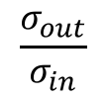
$$\frac{σ_{out}}{σ_{in}}$$
2.0
1.5
1.25
1.0
0.75
0.5
0.25
0
0.15
0.3
0.45
0.6
0.75
0.9
1.05
1.2
slope
Mechanical dissipation pattern

Slide 3
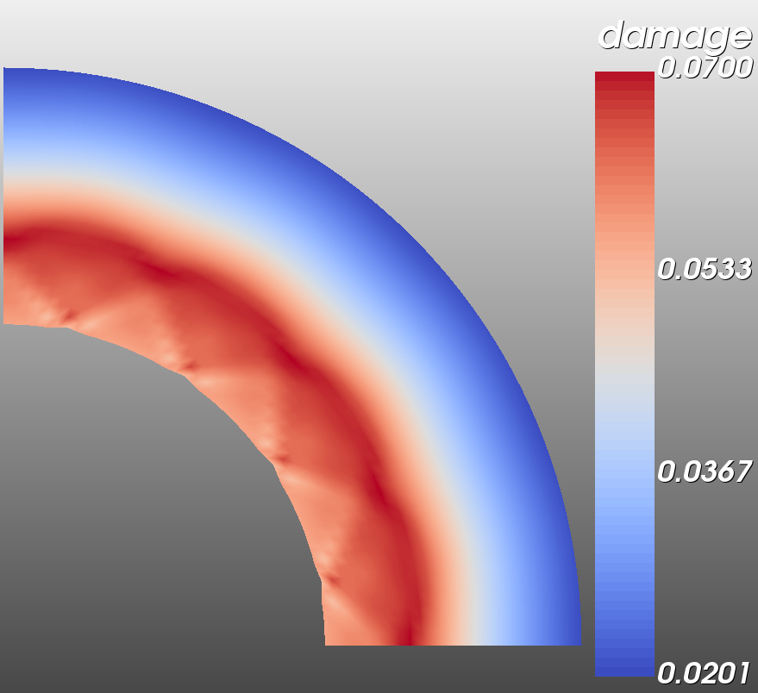
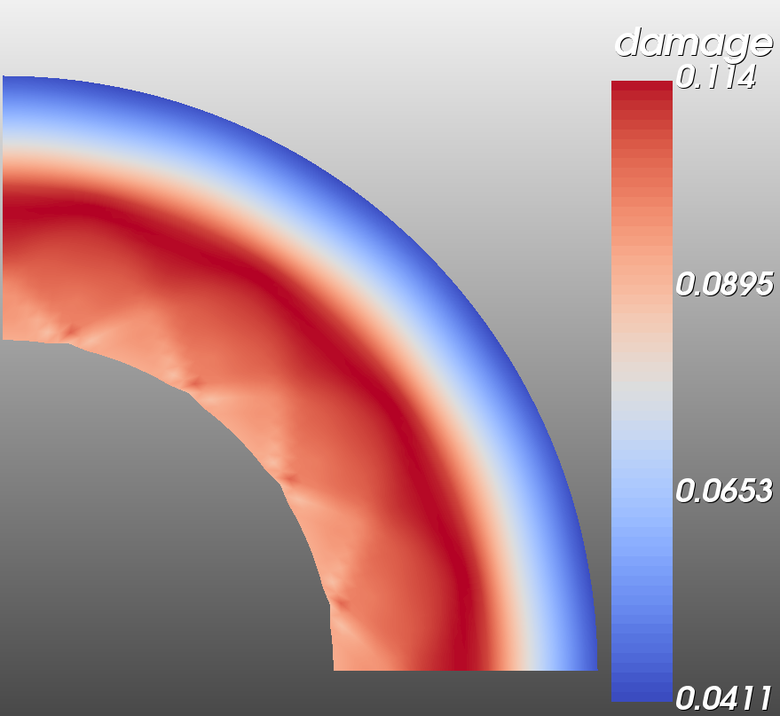
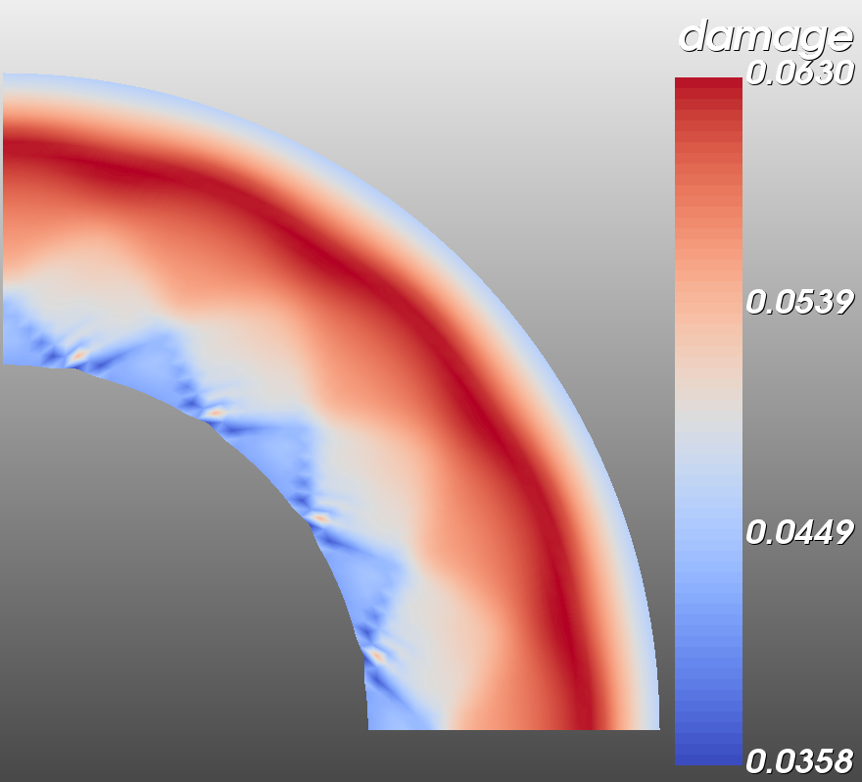
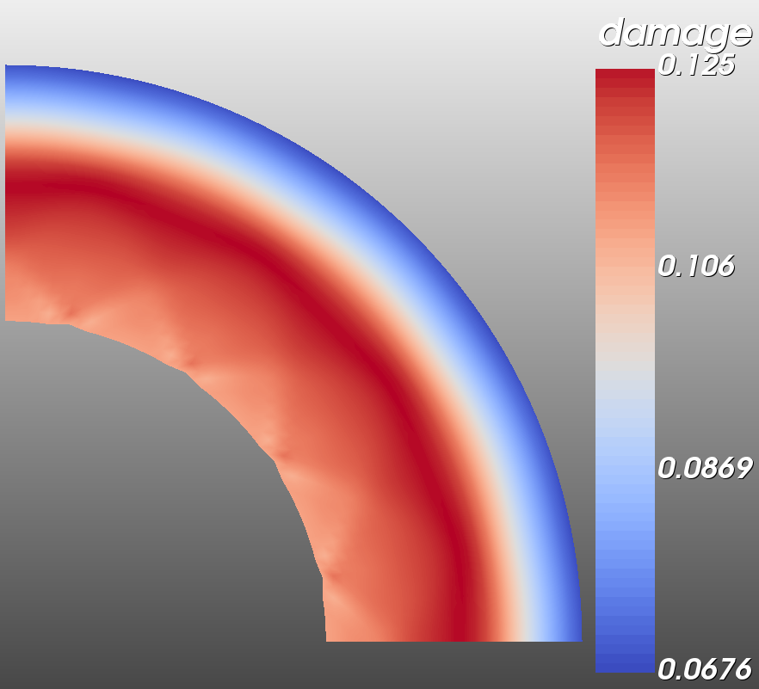
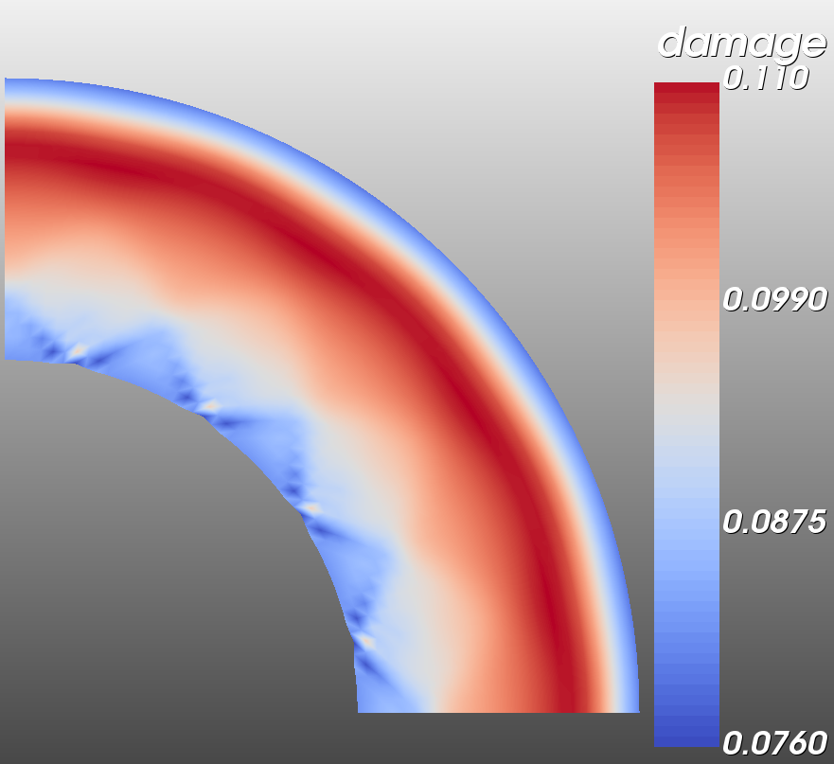
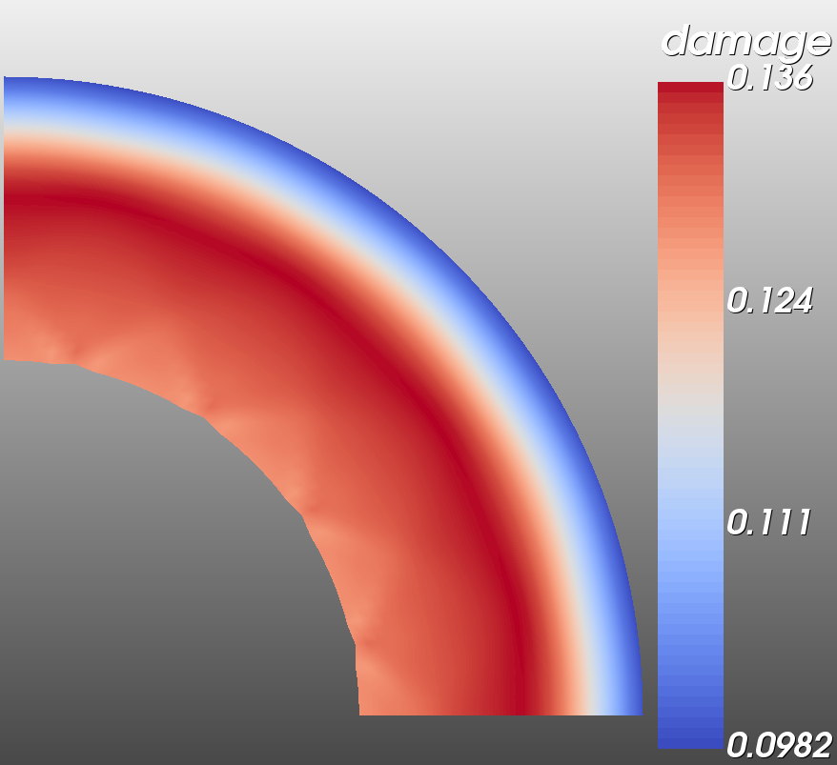
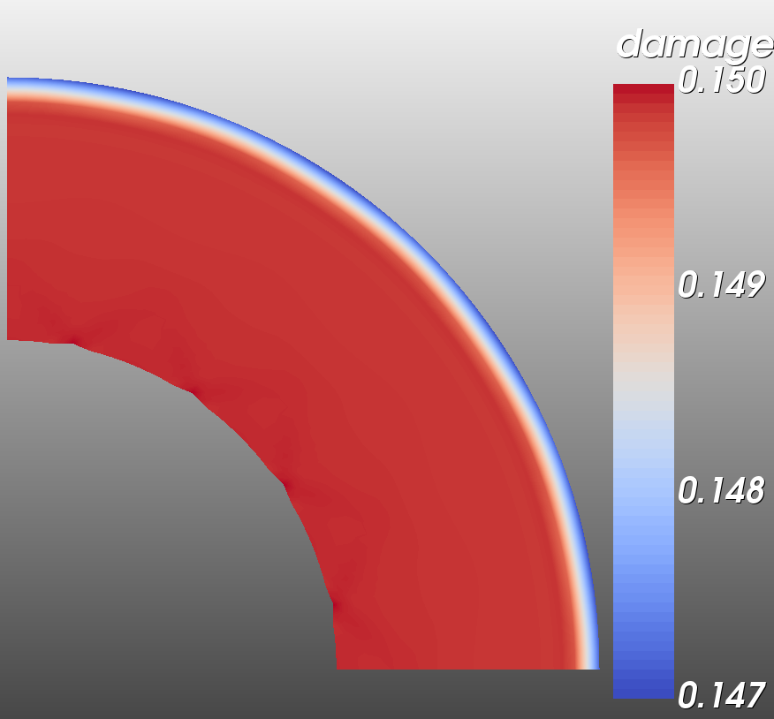
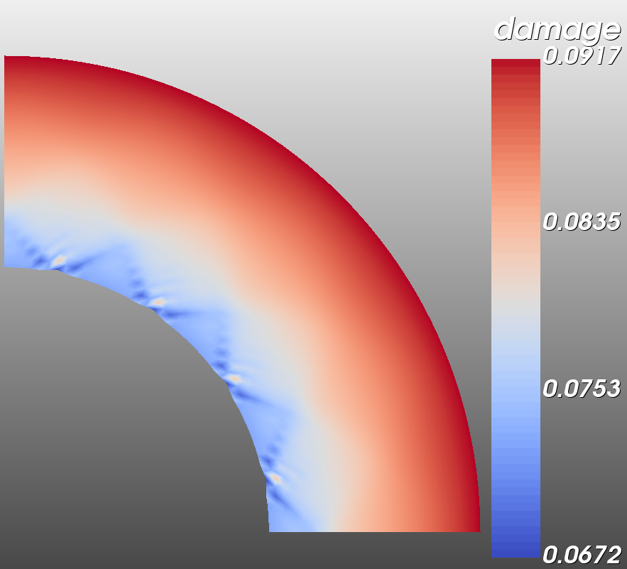
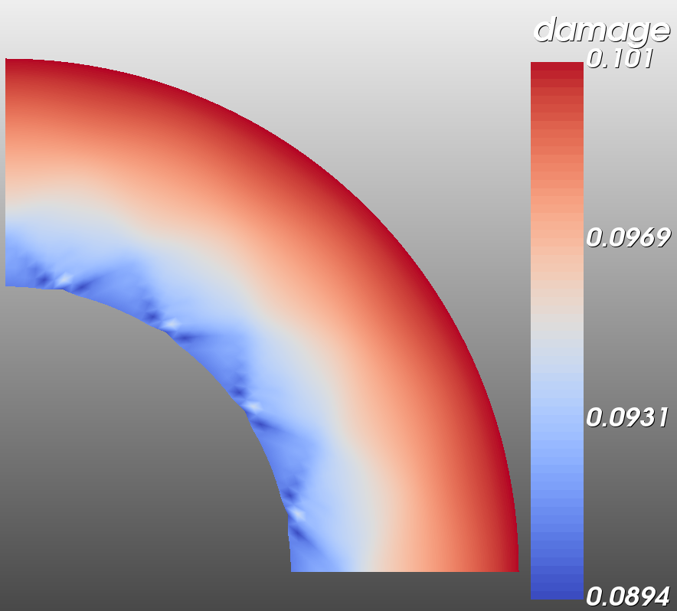
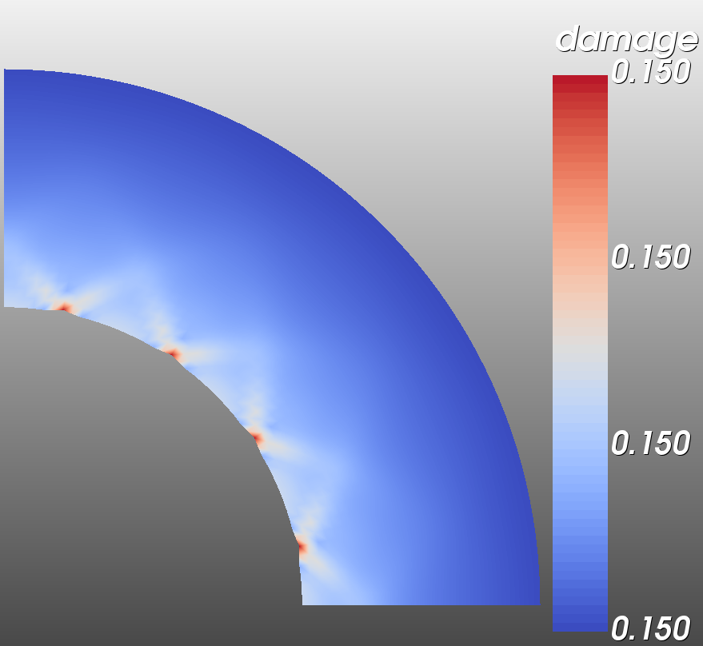
$$\frac{σ_{out}}{σ_{in}}$$
1.0
(0.55, 0.95)
(0.45, 0.83)
0.75
(0.55, 0.8)
(0.3, 0.75)
(0.45, 0.75)
0.5
(0.15, 0.67)
(0, 0.5)
(0.3, 0.5)
(0.15, 0.33)
0.25
(0, 0.25)
0
0.15
0.3
0.45
0.55
slope
Damage pattern

Slide 4
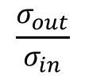
$$\frac{σ_{out}}{σ_{in}}$$
Time step=60
Time step=100
1.0
(0.55, 0.95)
(0.45, 0.83)
Time step=100
0.75
Time step=100
(0.55, 0.8)
(0.3, 0.75)
(0.45, 0.75)
Time step=100
0.5
(0.15, 0.67)
(0, 0.5)
(0.3, 0.5)
(0.15, 0.33)
0.25
(0, 0.25)
0
0.15
0.3
0.45
0.55
slope
Damage pattern

Slide 5
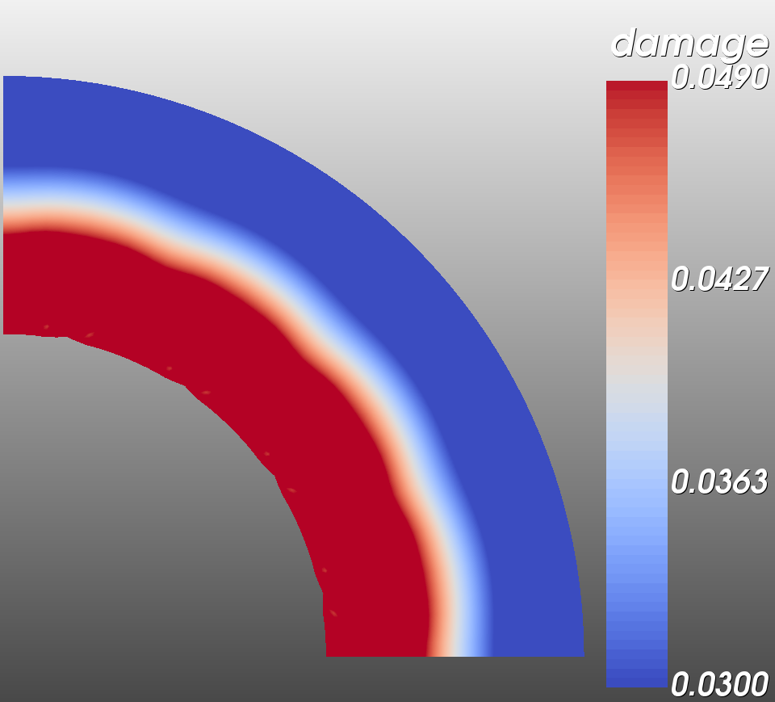
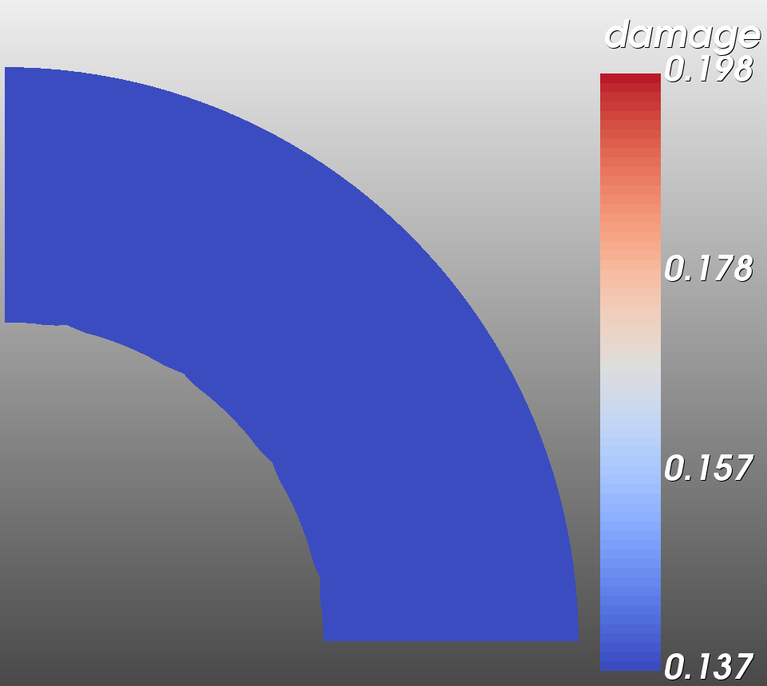
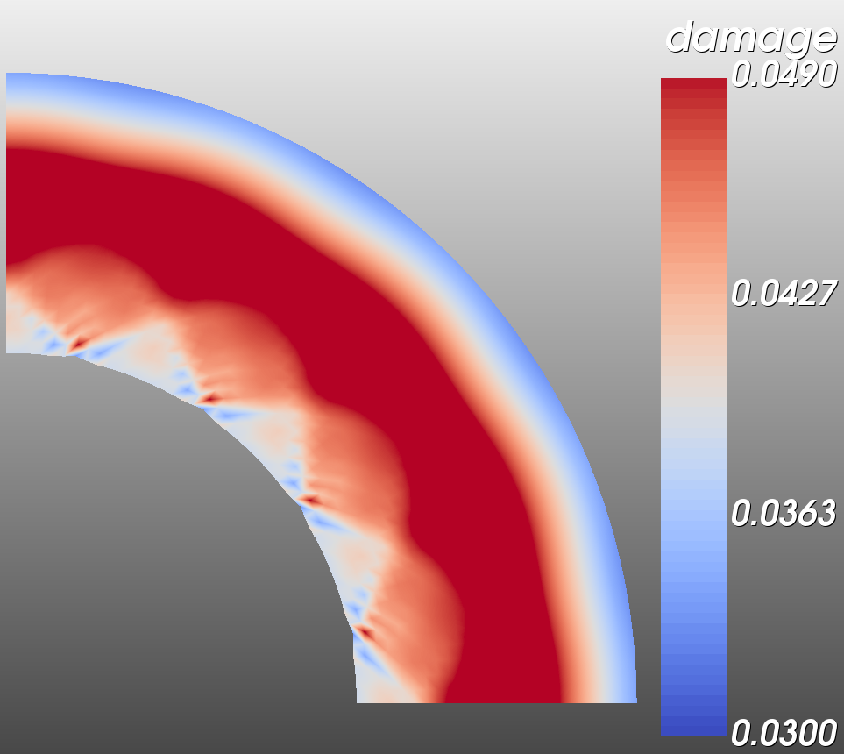
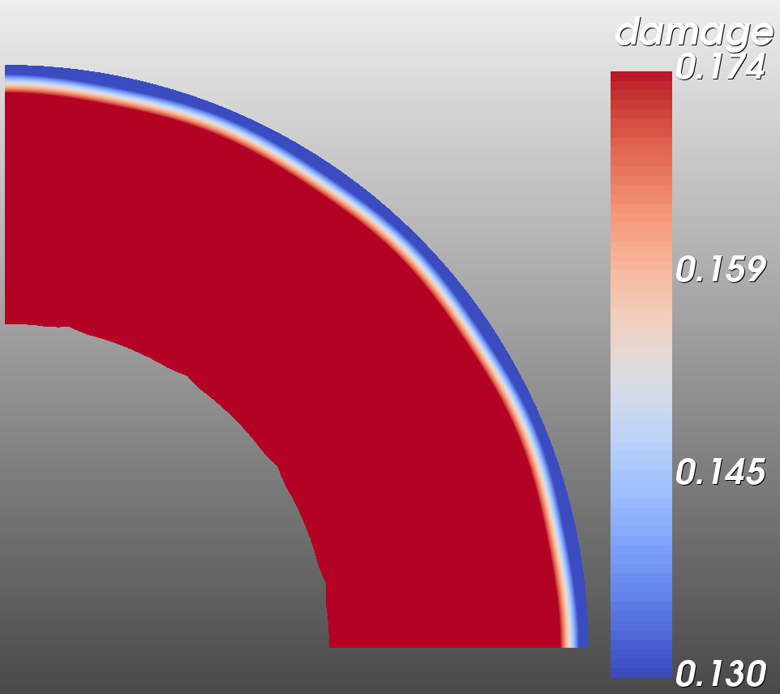
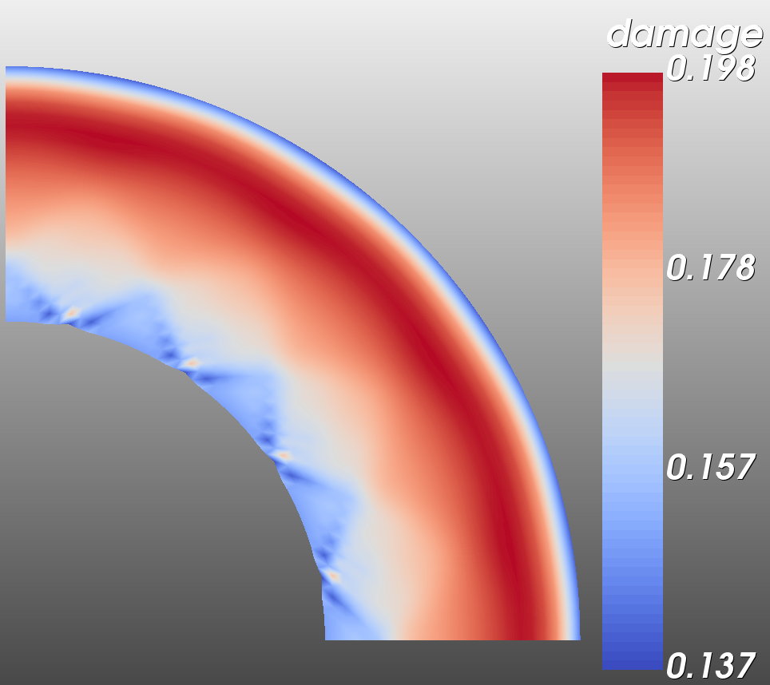
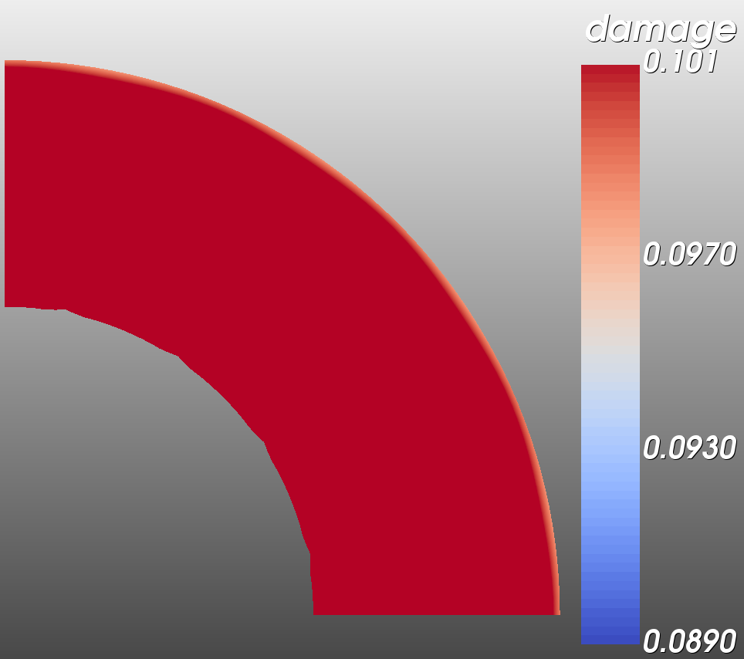
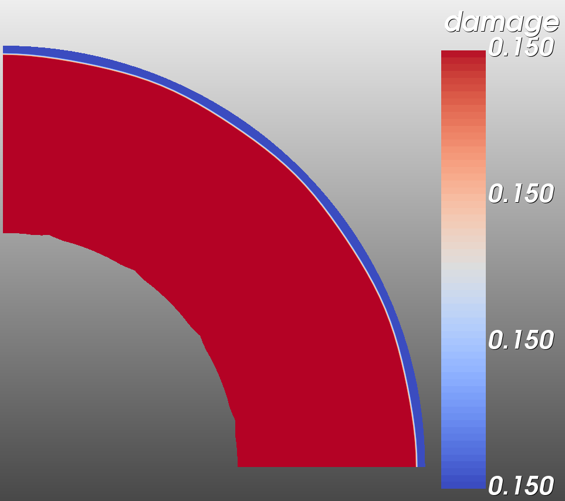

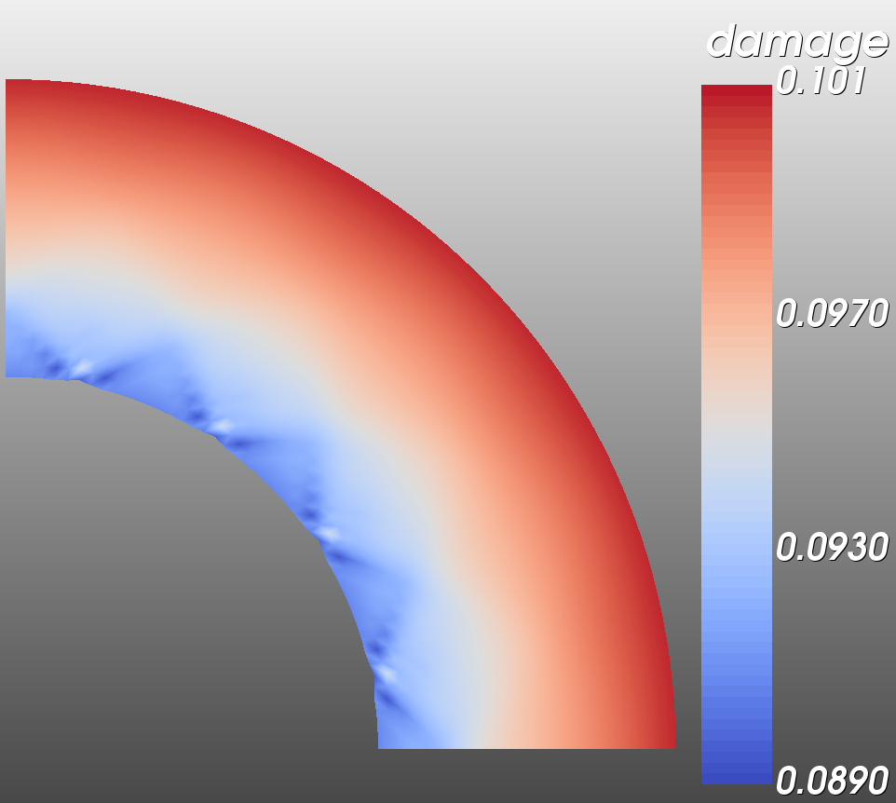
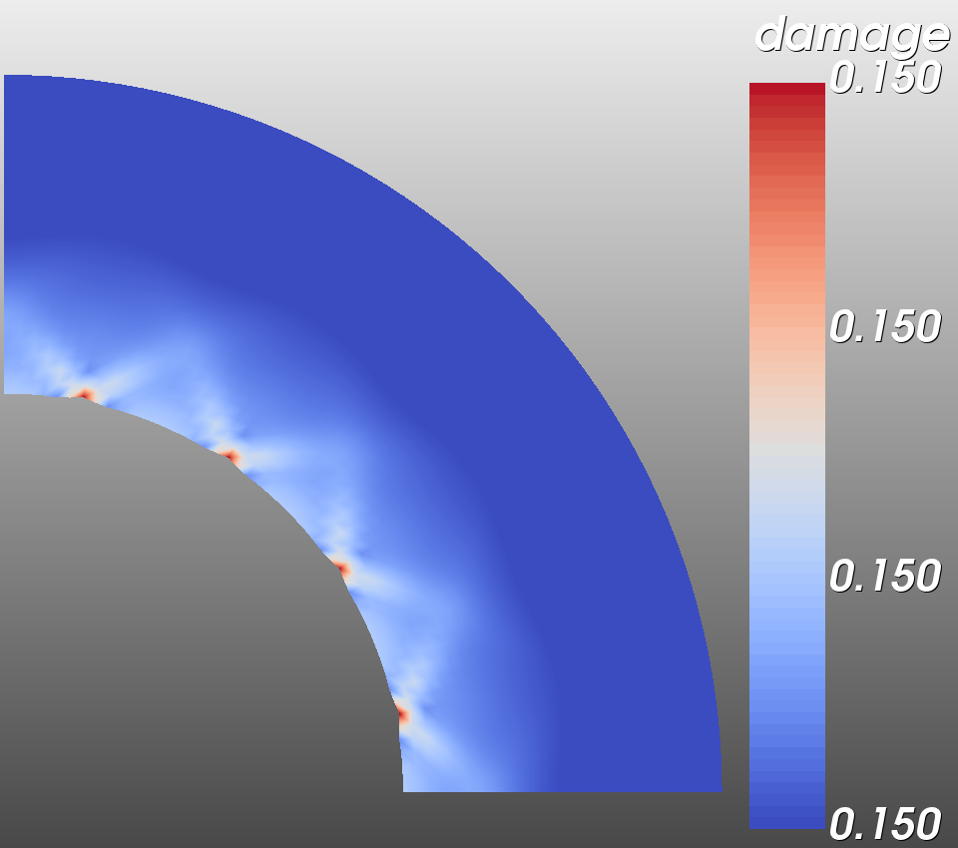
Time step=50
$$\frac{σ_{out}}{σ_{in}}$$
Time step=100
(0.55, 1.0)
1.0
Time step=100
(0.45, 0.83)
(0.55, 0.83)
0.75
Time step=100
(0.3, 0.75)
(0.45, 0.75)
Time step=100
0.5
(0.15, 0.67)
(0, 0.5)
(0.3, 0.5)
(0.15, 0.33)
0.25
(0, 0.25)
0
0.15
0.3
0.45
0.55
slope
Damage pattern (same scale)

Slide 6
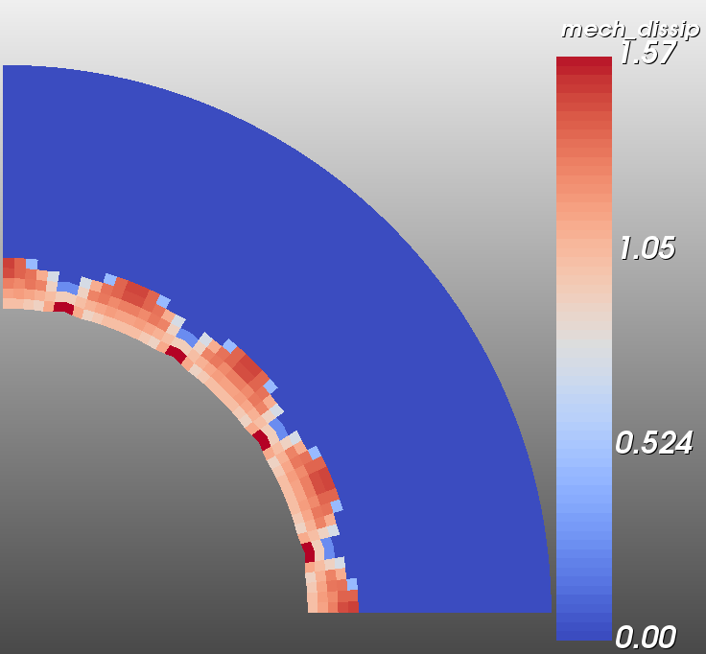
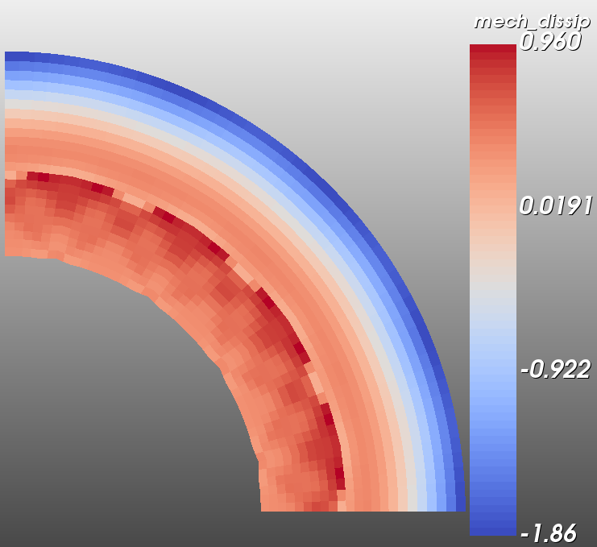
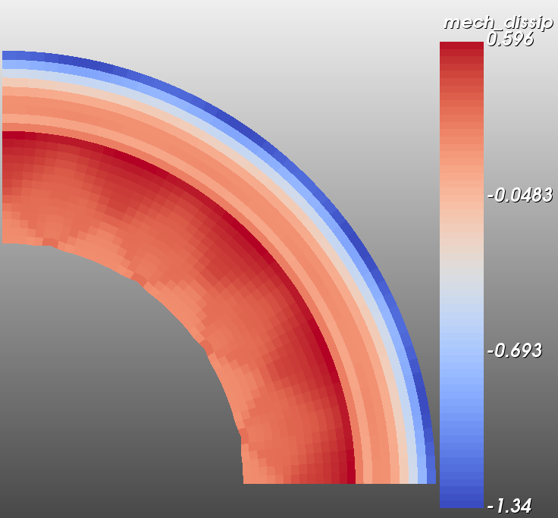
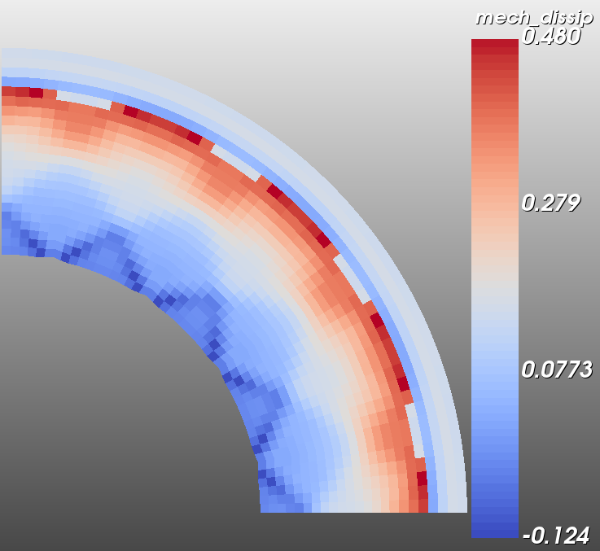
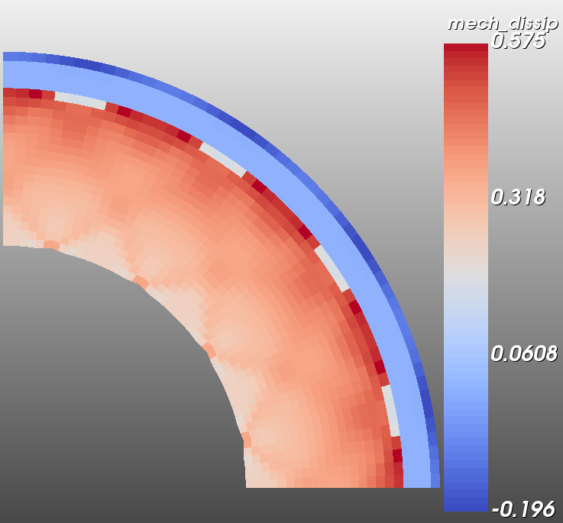
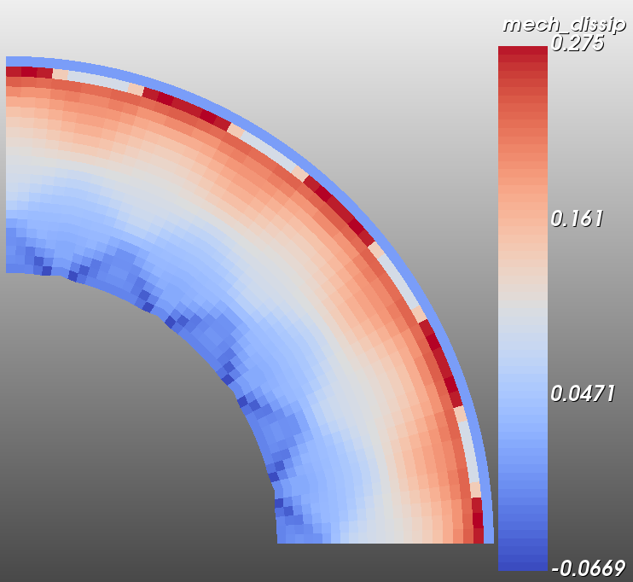
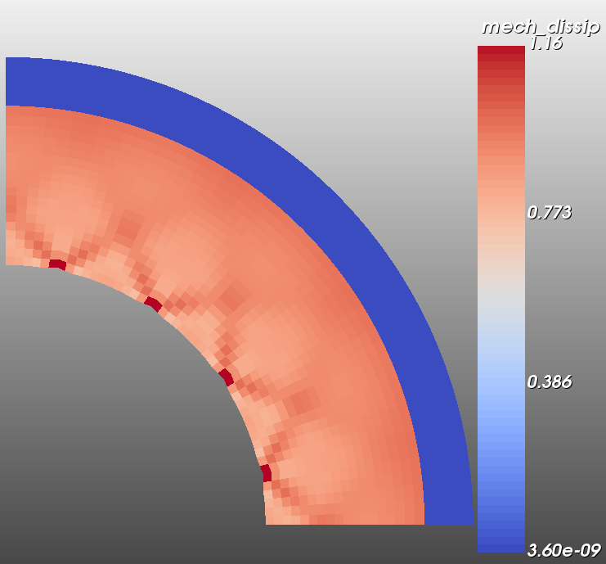
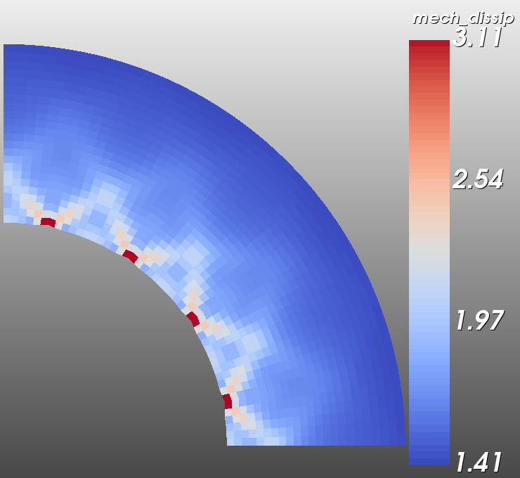
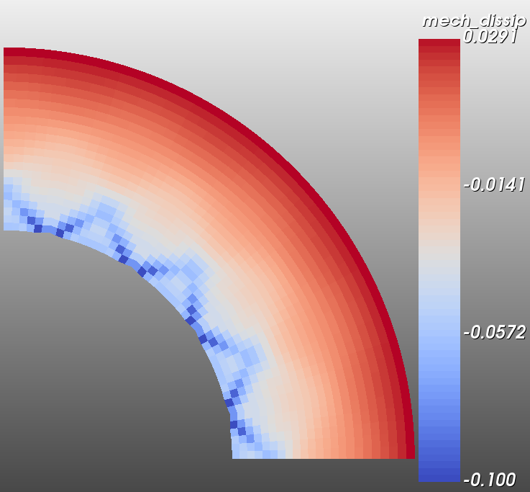
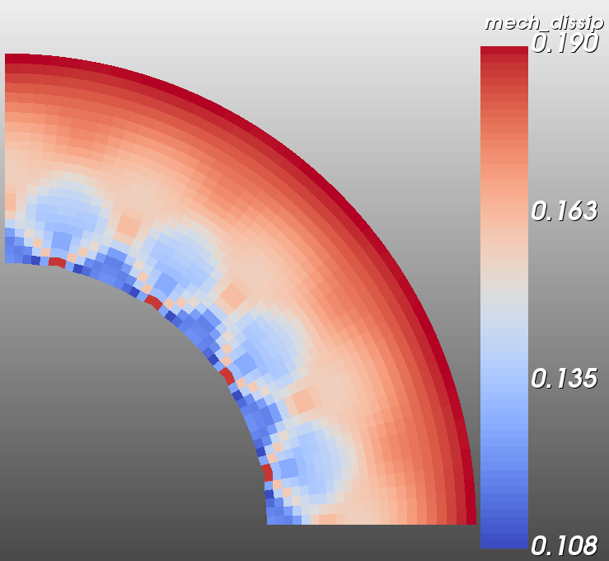

$$\frac{σ_{out}}{σ_{in}}$$
Time step=60
Time step=100
1.0
(0.55, 0.95)
(0.45, 0.83)
Time step=100
0.75
Time step=100
(0.55, 0.8)
(0.3, 0.75)
(0.45, 0.75)
Time step=100
0.5
(0.15, 0.67)
(0, 0.5)
(0.3, 0.5)
(0.15, 0.33)
0.25
(0, 0.25)
0
0.15
0.3
0.45
0.55
slope
Mechanical dissipation pattern

Slide 7
Mechanical dissipation pattern corresponds very well with the bifurcation in damage pattern
Question: what does “mechanical dissipation” being negative mean??

Slide 8
Time step=50
$$\frac{σ_{out}}{σ_{in}}$$
Time step=100
(0.55, 1.0)
1.0
Time step=100
(0.45, 0.83)
(0.55, 0.83)
0.75
Time step=100
(0.3, 0.75)
(0.45, 0.75)
Time step=100
0.5
(0.15, 0.67)
(0, 0.5)
(0.3, 0.5)
(0.15, 0.33)
0.25
(0, 0.25)
0
0.15
0.3
0.45
0.55
slope
Damage pattern (same scale)

Slide 9
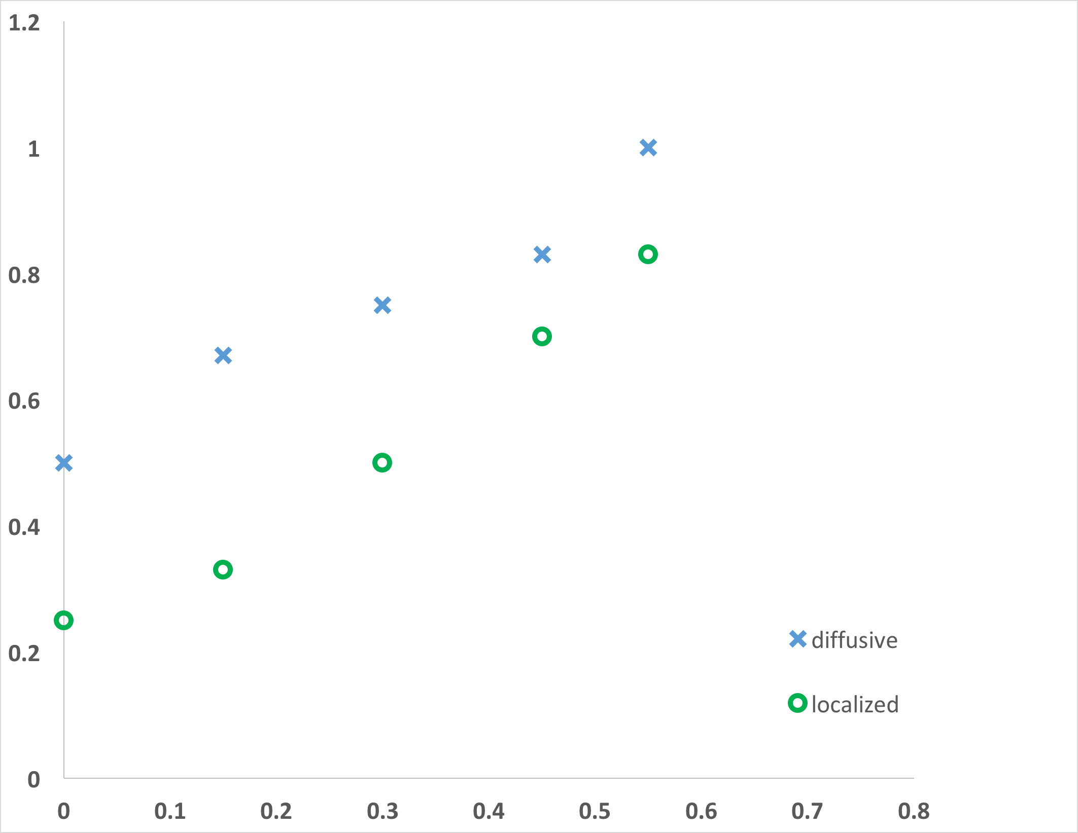
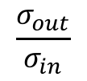
$$\frac{σ_{out}}{σ_{in}}$$
damage
0.030
0.049
damage
0.137
0.198
damage
damage
0.130
0.174
damage
0.089
0.101
0.149
0.150
slope of the yield surface

Slide 10
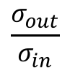
$$\frac{σ_{out}}{σ_{in}}$$
damage
0.030
0.049
damage
0.137
0.198
damage
damage
0.130
0.174
damage
0.089
0.101
0.149
0.150
slope of the yield surface

